Slide 1

Resort Booking Web Application
18EC81 : BE Major Project Phase I Presentation
Anand 1RV20EC021
Guide Name: Dr. Rajani Katiyar
Designation: Associate Professor
Department of Electronics and Communication Engineering
*
Department of ECE
1

Slide 2
General Instructions
Font – Calibri
Font size for headings – 54
Font size for text – 40
For the tables, follow the style provided
*
Department of ECE
2

Slide 3
Outline
Outline
About the organization (for internship students)
Introduction
Motivation
Problem Statement
Objectives of the project
Literature Survey
Methodology
Work done so far (Use this from phase 2 presentation onwards)
Work plan for next phase (Use this from phase 2 presentation onwards)
Project timeline
References
About the organization (for internship students)
Introduction
Motivation
Problem Statement
Objectives of the project
Literature Survey
Methodology
Work done so far (Use this from phase 2 presentation onwards)
Work plan for next phase (Use this from phase 2 presentation onwards)
Project timeline
References

Slide 4
About the organization
Give a brief introduction about the organization
Mention your role as an intern (details of your team)
*
Department of ECE
4

Slide 5
About the organization
Founded in 2005, GyanSys is a leading global mid-tier provider of digital transformation solutions and systems integration supporting global enterprise customers. We specialize in solutions implementations, managed services, and data analytics spanning SAP, Salesforce, Microsoft, and other prime enterprise platforms. Using a mature blended delivery model with over 1,500 consultants, we support over 150 enterprise customers across the Americas, Europe, and APAC.
*
Department of ECE
5

Slide 6
GyanSys has extensive experience with SAP S/4HANA, IBP, Ariba, SuccessFactors, CX (formerly C/4HANA), and PLM solutions, offering pooled hour, 24x7 global support services employing SAP AMS and PCoE certified delivery centers in North America, India, and the Philippines. Core SAP expertise is augmented by our differentiated Salesforce services for the enterprise, leveraging significant experience in the Sales, Service, Community, Marketing, and Commerce clouds and their integration into complex multi-cloud environments. GyanSys is also a distinguished Microsoft Gold Partner, providing enterprise application development, Azure DevOps, cloud migration, cloud analytics, and Microsoft 365 services.
*
Department of ECE
6

Slide 7
Introduction
In today's fast-paced world, where convenience and efficiency are paramount, the hospitality industry faces the challenge of providing seamless booking experiences to its customers.
Our project, the Resort Booking System, addresses this challenge by offering a user-friendly and comprehensive web-based platform designed to simplify the booking process for various resort packages.
With the Resort Booking System, users can effortlessly explore, select, and reserve their desired packages, while resort staff can efficiently manage reservations and availability.
*
Department of ECE
7

Slide 8
Introduction
The Resort Booking System not only caters to the needs of modern travelers but also empowers resort owners and managers with tools to optimize their operations.
By streamlining the booking process, reducing manual workload, and enhancing customer satisfaction, our system aims to elevate the overall experience for both guests and resort staff.
With a focus on usability, functionality, and innovation, the Resort Booking System represents a step forward in revolutionizing the way resorts interact with their customers in the digital age.
*
Department of ECE
8

Slide 9
Motivation
The hospitality industry is rapidly evolving, with an increasing demand for seamless and efficient booking experiences.
Traditional booking methods may be cumbersome for both customers and resort staff, leading to inefficiencies and potential revenue loss.
By developing a streamlined Resort Booking System, we aim to enhance customer satisfaction, optimize resort operations, and stay competitive in the market.
*
Department of ECE
9

Slide 10
Problem Statement
The current booking process at resorts is often manual, time-consuming, and prone to errors.
Customers may face difficulties in finding suitable packages, making reservations, and receiving timely confirmations.
Resort staff may struggle to manage bookings, availability, and customer inquiries efficiently.
*
Department of ECE
10

Slide 11
Objectives of the Project
Simplify the booking process: Develop an intuitive and user-friendly interface for browsing, searching, and booking resort packages.
Enhance efficiency: Automate booking management tasks to reduce manual intervention and streamline operations for resort staff.
Improve customer experience: Implement features such as notifications, reminders, and personalized profiles to enhance user satisfaction.
Enable data-driven decisions: Incorporate reporting and analytics capabilities to provide insights into booking trends, revenue generation, and occupancy rates.
*
Department of ECE
11

Slide 12
Literature Survey
Before executing the objectives, you are instructed to thoroughly do a literature review of the state-of-the-art
You may refer relevant and reputed journals available through IEEE explore or other good sources. Kindly avoid predatory journal publications.
With the instructions from your guide, pick a minimum of 25 relevant papers
Study the major findings from those papers
If a gap is observed, you can focus to that
Present a table as shown in next slide
*
Department of ECE
12

Slide 13
Literature Survey
Sl No | Paper Title, Journal Name, Year | Major findings / observations
1 | Development of a Comparison Based Hotel and Resort Booking System in Bangladesh– Journal of Software Engineering and Applications , Vol.14 No.5, May 2021 | Payment option feasible for all country users. Cover all the tourist places. Search option based on check in and check out date, location , number of people etc..
2 | Relevance of the features regarding the performance of booking websites – Sage Journal Volume 26, Issue 6, May 2020 | Key Features Impacting Booking Website Performance. User-Centric Design Performance Optimization Impact on Business Success
*
Department of ECE
13

Slide 14
Literature Survey
Sl No | Paper Title, Journal Name, Year | Major findings / observations
3 | Factors That Influence Online Behavior In Purchasing Hotel Room Via Website Among Tourist – European Journal of Molecular & Clinical Medicine, 2021 | Price Sensitivity Personalized recommendations and customized offers tailored to tourists' preferences. Tourists are more likely to book hotel rooms online through websites that prioritize security measures, such as SSL encryption, secure payment gateways, and trust seals.
4 | Application of Revised Importance–Performance Analysis to Investigate Critical Service Quality of Hotel Online Booking.- February 2021 | Customer and business relationship. Review system that accurately analyse the customer satisfaction
*
Department of ECE
14

Slide 15
Literature Survey
Sl No | Paper Title, Journal Name, Year | Major findings / observations
5 | Dynamic pricing for online hotel demand: The case of resort hotels in Majorca– Journal of Vacation Marketing, 2022 | seasonality, the number of rooms available, the hotel location, and the tourist profile affect dynamic pricing the booking horizon limitation leads to larger revenue decreases under elastic demand
6 | Post-epidemic factors influencing customer's booking intent for a hotel or leisure spot: an empirical study - Journal of Enterprise Information Management, 2022 | Impact of new-age AI-driven technology solutions
*
Department of ECE
15

Slide 16
Literature Survey
Sl No | Paper Title, Journal Name, Year | Major findings / observations
7 | Use of Mobile Technologies in Tourism: Natural Health Resorts Study– Mediterranean Journal of Social Sciences, Vol 11 No 4 July 2020 | Evaluation of website mobile devices' friendliness in the natural health resort sector. It warns management, their marketing consultants, and web site developers about the opportunities they are missing by not supporting mobile users sufficiently
8 | A correlation graph based approach for personalized and compatible web apis recommendation in mobile app development, IEEE Transactions on Knowledge and Data Engineering, 2022.
*
Department of ECE
16

Slide 17
Literature Survey
Sl No | Paper Title, Journal Name, Year | Major findings / observations
9 | Creating a platform using html, css and java script methods and strengthening education with this steam- Confrencea, vol. 5, no. 5, pp. 17–38, 2022 | Locking range enhancement techniques Target input frequency ranges of 7.8, 11.1, and 11.7-GHz on 180 nm standard CMOS technology 47.8% enhancement in the locking-range
10 | Development of e-healthcare management system using php, javascript and cascading style sheets,” in Journal of Physics: Conference Series, IOP Publishing, vol. 1962, 2021, p. 012 030.
*
Department of ECE
17

Slide 18
Literature Survey
Sl No | Paper Title, Journal Name, Year | Major findings / observations
11 | JavaScript for modern web development: building a web application using HTML, CSS, and JavaScript. BPB Publications, 2020. | Locking range enhancement techniques Target input frequency ranges of 7.8, 11.1, and 11.7-GHz on 180 nm standard CMOS technology 47.8% enhancement in the locking-range
12 | Integrated content and network-based service clustering and web apis recommendation for mashup development, IEEE Transactions on Services Computing, vol. 13, no. 1, pp. 99– 113, 2022.
*
Department of ECE
18

Slide 19
Literature Survey
Sl No | Paper Title, Journal Name, Year | Major findings / observations
13 | Customer centric hybrid recommendation system for e-commerce applications by integrating hybrid sentiment analysis, Electronic Commerce Research, vol. 23, no. 1, pp. 279–314, 2023. | Locking range enhancement techniques Target input frequency ranges of 7.8, 11.1, and 11.7-GHz on 180 nm standard CMOS technology 47.8% enhancement in the locking-range
14 | React js, php, wordpress development & cpanel management, GSFC University, Vadodara, Tech. Rep., 2023.
*
Department of ECE
19

Slide 20
Literature Survey
Sl No | Paper Title, Journal Name, Year | Major findings / observations
15 | Injection-Locked Frequency Divider Topology and Design Techniques for Wide Locking-Range and High-Order Division – Journal of Solid State Circuits, 2017 | Locking range enhancement techniques Target input frequency ranges of 7.8, 11.1, and 11.7-GHz on 180 nm standard CMOS technology 47.8% enhancement in the locking-range
16 | Follow the above format. You may add up to a minimum of 20 relevant references and observations.
*
Department of ECE
20

Slide 21
Literature Survey
Sl No | Paper Title, Journal Name, Year | Major findings / observations
17 | Project Guide to UX Design: For user experience designers in the field or in the making. New Riders, 2023. | Locking range enhancement techniques Target input frequency ranges of 7.8, 11.1, and 11.7-GHz on 180 nm standard CMOS technology 47.8% enhancement in the locking-range
18 | Personalized apis recommendation with cognitive knowledge mining for industrial systems, IEEE Transactions on Industrial Informatics, vol. 17, no. 9, pp. 6153–6161, 2020.
*
Department of ECE
21

Slide 22
Design Methodology
Gather and analyze requirements for the Resort Booking System, including user needs, business objectives, and technical constraints.
Identify key features, user stories, and acceptance criteria based on the project objectives.
Design the architecture of the Resort Booking System, including database schema, application layers, and user interface.
Define models for packages, users, bookings, and other entities using ASP.NET Core MVC conventions.
*
Department of ECE
22

Slide 23
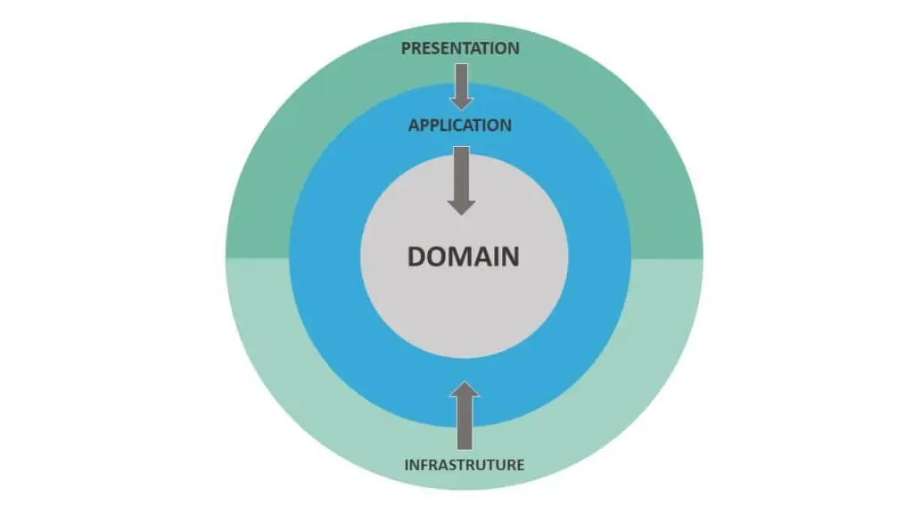
Design Methodology
Clean architecture is used with ASP.NET core MVC. The Clean Architecture places the application model and the business logic at the center of the application.
*
Department of ECE
23

Slide 24
Design Methodology
To store the data related to the project like booking details, user details , payment details etc.., Microsoft SQL server is used .
ASP.NET CORE MVC architecture is used for the development of the resort booking system. It implements the model-view-controller (MVC) pattern.
MVC is a software design pattern that separates an application into three main components: the model, the view, and the controller.
Entity framework is used to work with database. Code first approach is used to create the database.
*
Department of ECE
24

Slide 25
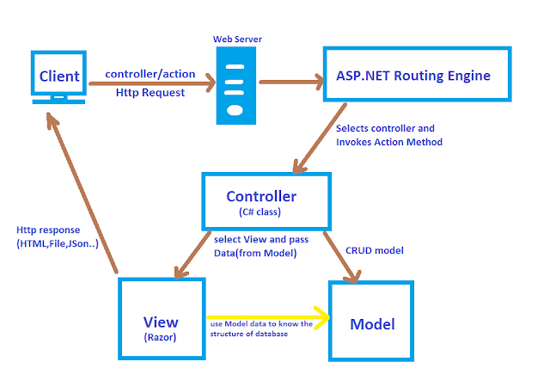
Design Methodology
*
Department of ECE
25

Slide 26
Design Methodology
Identity interface is used for the user management. It gives options for user authentication and authorization.
User interface for the resort booking system is designed using Razor views and Bootstrap for responsive design.
Design the resorts and room management and searching mechanism for users.
Design different user interface for the customer and admin.
Admin feature like data driven graphs and charts are included to asily analyse the booking and revenuegenerated.
*
Department of ECE
26

Slide 27
Details of Software / Hardware
Present the details of the software and hardware requirements for your project
Software used for frontend include HTML, CSS, JavaScript and razor pages.
Software used for the backend include ASP.NET core MVC, ASP.NET Entity framework and ASP.NET web API.
Microsoft SQL server is used to store and manage the data.
*
Department of ECE
27

Slide 28
Timeline of the Project (modify this template accordingly)
 | April 2022 |  |  |  | May 2022 |  |  |  | June 2022
 | Week 01 | Week 02 | Week 03 | Week 04 | Week 01 | Week 02 | Week 03 | Week 04 | Week 01 | Week 02 | Week 03 | Week 04
Literature Survey
Specifications study
Architecture study
Design
Development or Implementation
Software study
Supporting courses
Documentation
Literature Survey
*
Department of ECE
28

Slide 29
References
Sl No | Author, Title of paper, Journal | Year
1 | Behzad Razavi, “ A Millimeter-Wave Circuit Technique”, IEEE journal of solid-state circuits, vol. 43, no. 9 | 2008
2 | Follow the above format
3
4
5
6
*
Department of ECE
29

Slide 30
Thank You
*
Department of ECE
30

